Slide 1

PROGRAMMING
Anonymous
Programming shape the way we think, or don't.

Slide 2
Requirements to fulfill
Snake
Food’s
Home & Play Screen’s

Slide 3
Requirements to fulfill
Snake

Slide 4
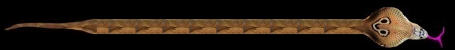


SNAKE (Behind Logic)

Slide 5
Requirements to fulfill
Food

Slide 6
Food’s (Classification)
Food
Animals
Fruits

Slide 7
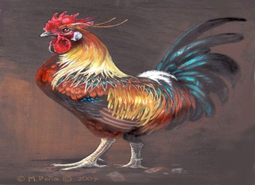
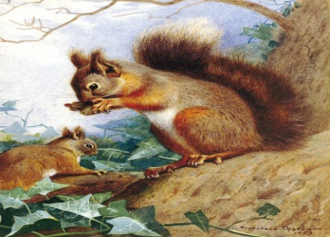
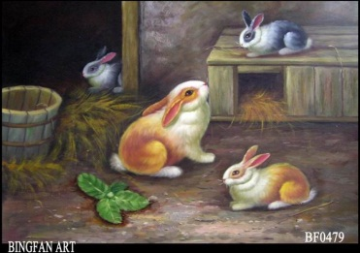
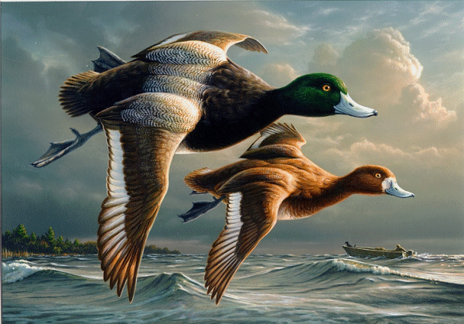
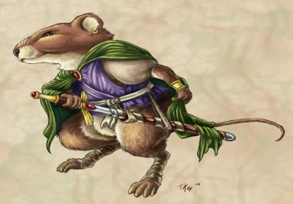
Food’s (Classification)
Animal’s

Slide 8
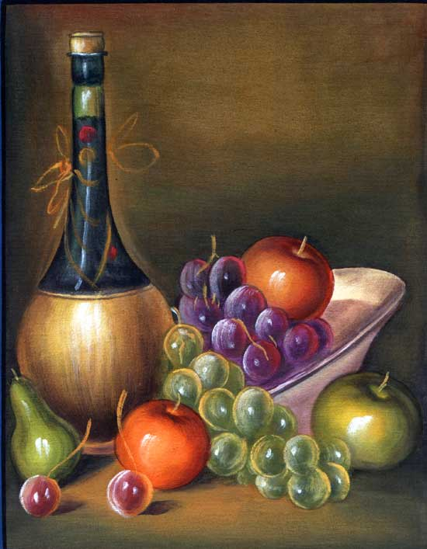

Food’s (Classification)
Fruit’s

Slide 9
Requirements to fulfill
Screen’s

Slide 10
Home & Play Screen’s
Screen’s
Home Screen
Play Screen
New game
Load game

Slide 11
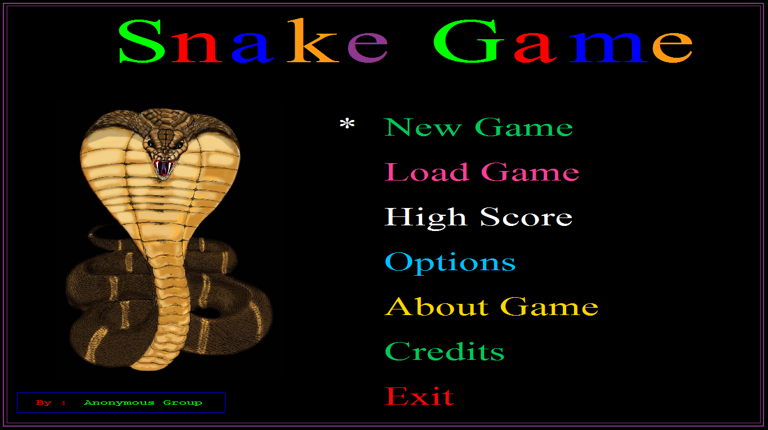
Home & Play Screen’s
Home Screen

Slide 12
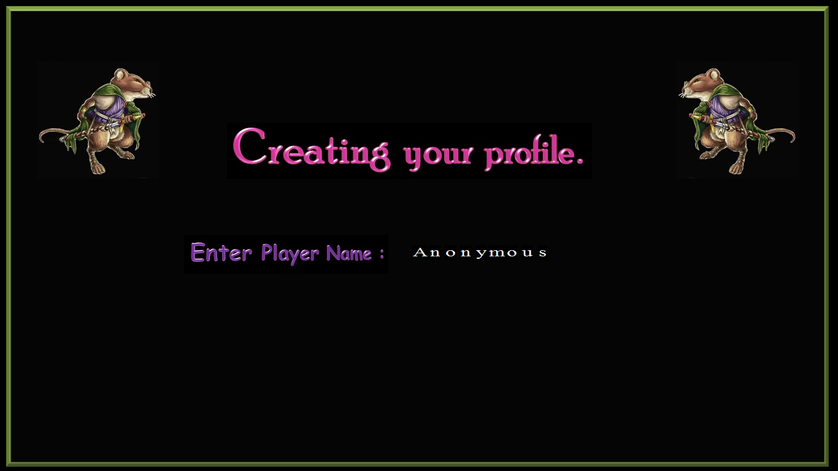
Home & Play Screen’s
New Game

Slide 13
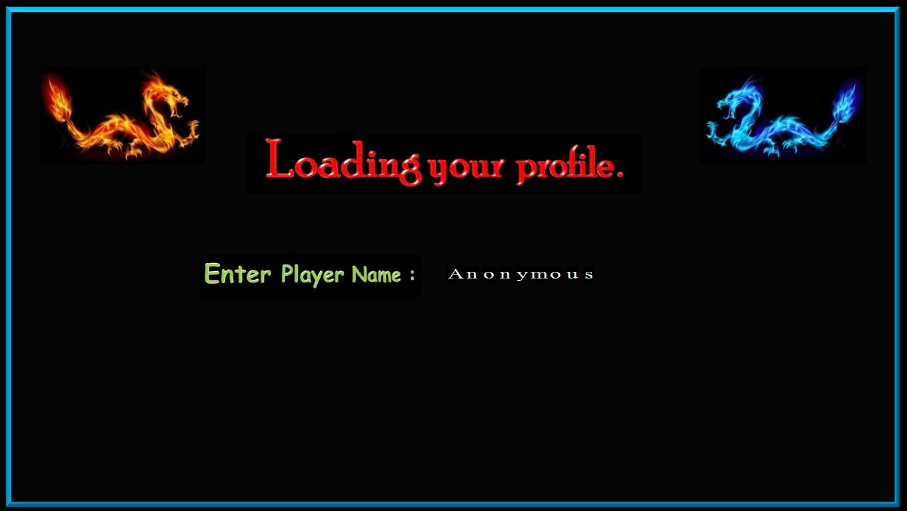
Home & Play Screen’s
Load game

Slide 14
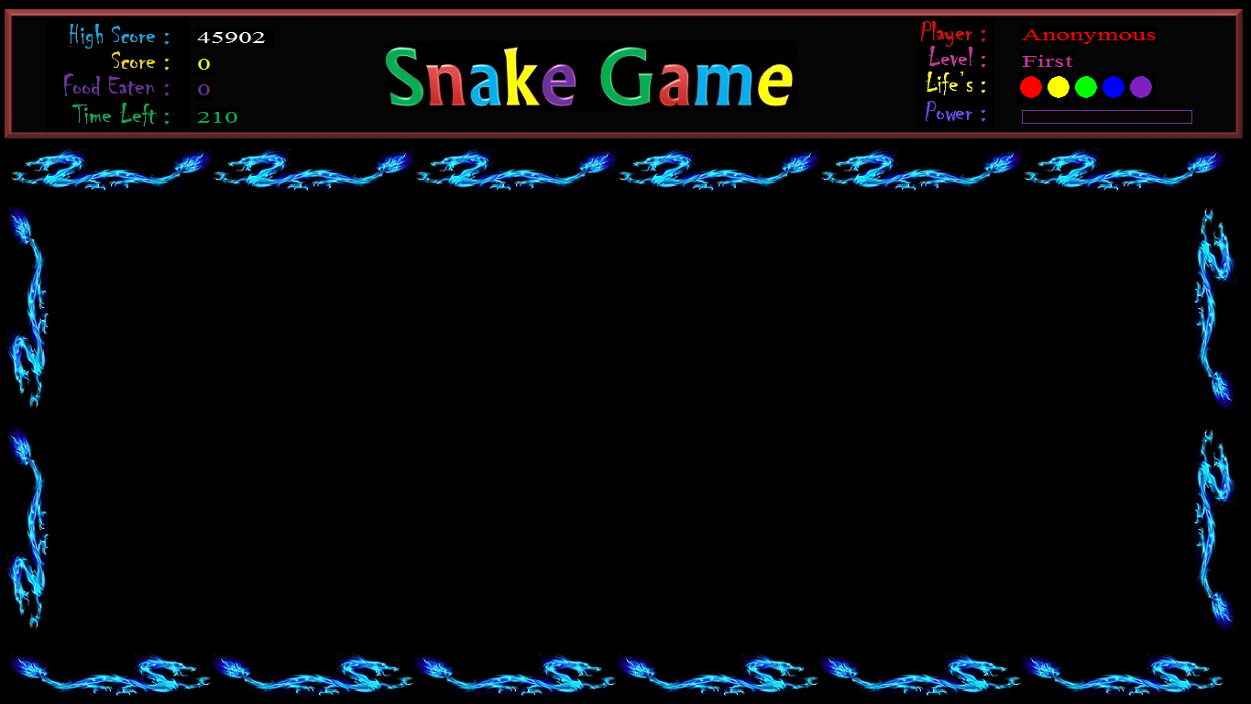
Home & Play Screen’s
Play Screen

Slide 15
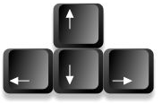

How “Snake & Food” Programmed ?
Keys Responsible for handling Snake
Z = 90 , z = 122
72
75
77
78
ASCII (American Standard
Code for Information Interchange)

Slide 16
How “Snake & Food” Programmed ?
1366 px
y = 50
X = x + 30
x = 50
( x , y )
760 px

Slide 17
How “Snake & Food” Programmed ?
1366 px
y = 50
X = x + 30
x = x+30 = 80
760 px

Slide 18
How “Snake & Food” Programmed ?
1366 px
y = 50
. . .
x = x +30 = 110
760 px

Slide 19
How “Snake & Food” Programmed ?
1366 px
y = 50
x >= 1366
760 px
X- =30

Slide 20
How “Snake & Food” Programmed ?
1366 px
y = 50
x - = 30
760 px

Slide 21

How “Snake & Food” Programmed ?
1366 px
y = 50
x - = 30
760 px

Slide 22
How “Snake & Food” Programmed ?
1366 px
X+ =30
y = 50
760 px
x < = 0

Slide 23
How “Snake & Food” Programmed ?

Slide 24
How “Snake” Programmed ?
Use these keys to handle the circle.
Z = 90 , z = 122
72
(For Snake Movement)
75
77
78
(For Poison)

Slide 25
How “Snake” Programmed ?
SO , HERE IS THE RESULT OF THIS
LOGIC
With some Enhancements.

Slide 26
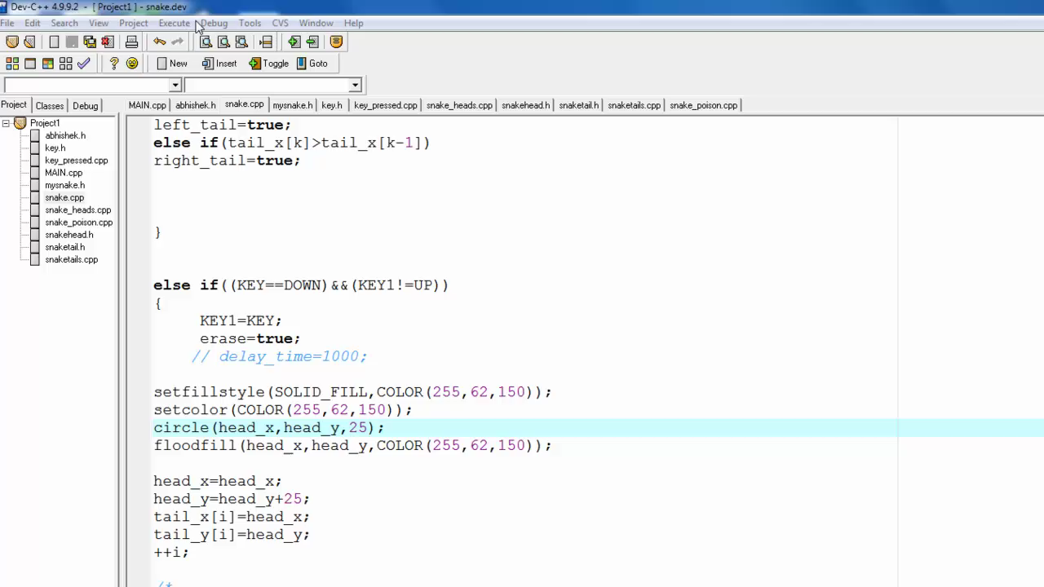
How “Snake & Food” Programmed ?

Slide 27
How “Snake” Programmed ?
Combining the Single “Circle” with some
“Other circles” to make “Snake Body”
as well as including head and tails to
Make complete snake.

Slide 28
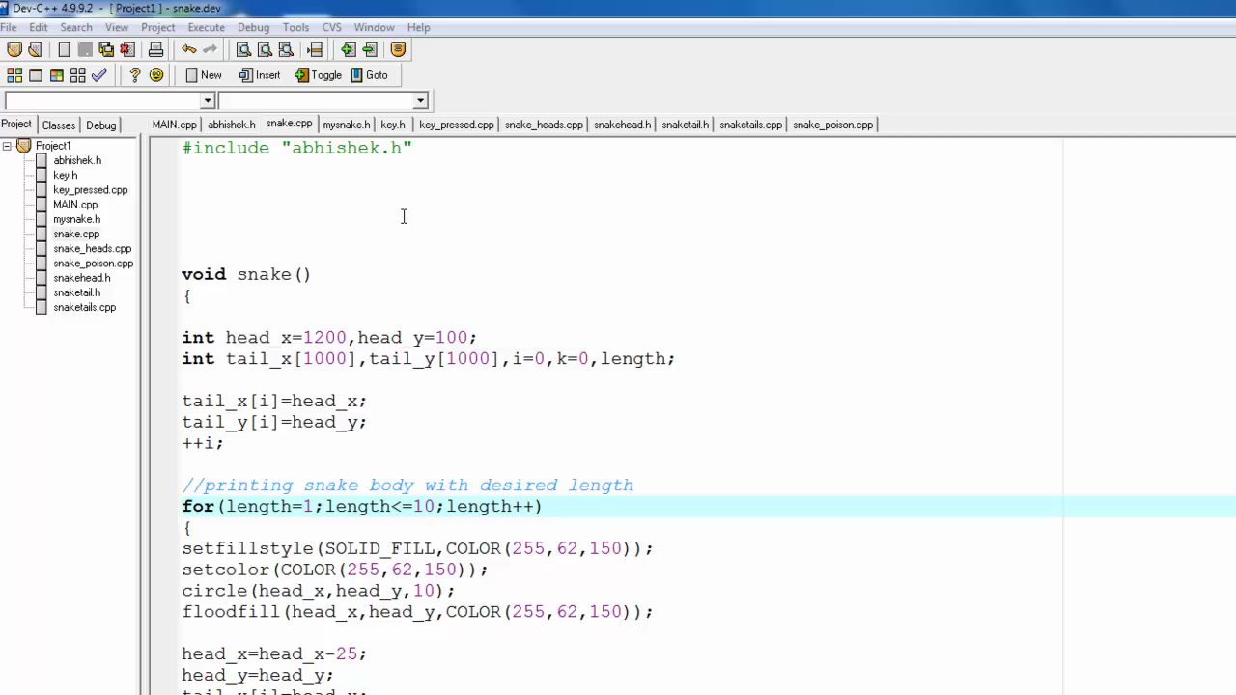
How “Snake” Programmed ?

Slide 29
How “Snake” Programmed ?
Use Advanced Graphics Concepts to give snake
-> Realisticism

Slide 30
How “Snake” Programmed ?
Most Upgraded Version of this game
-> Beyond My limits.

Slide 31
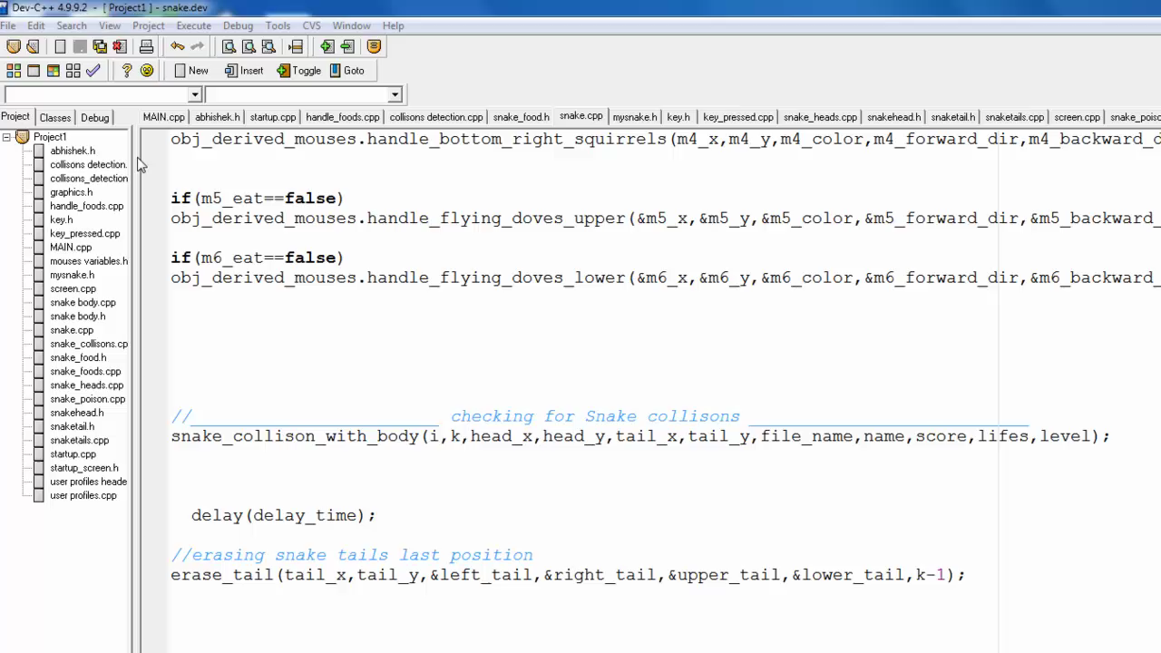
Complete Game . . .

